Slide 1


MA3831 Assignment3 Video Presentation
Timothy Avice Du Buisson

Slide 2
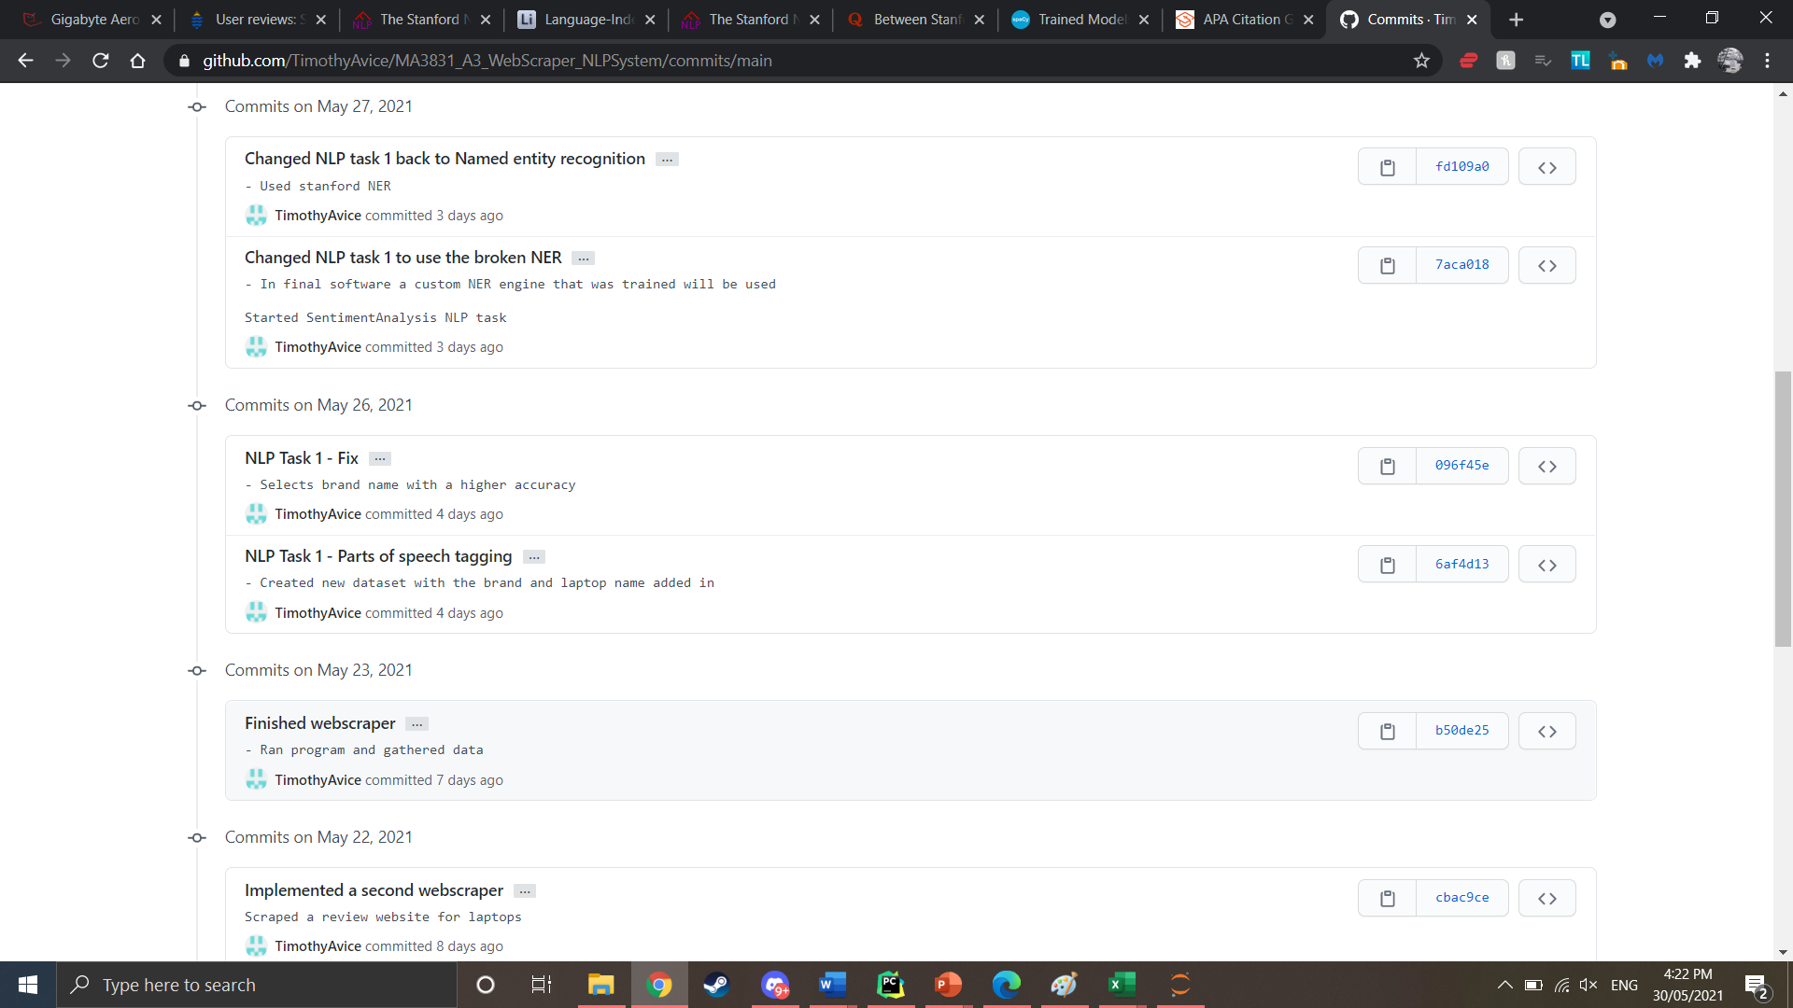
Code management
Repository Link: https://github.com/TimothyAvice/MA3831_A3_WebScraper_NLPSystem.git

Slide 3
Publishing
Request permission to use data

Slide 4

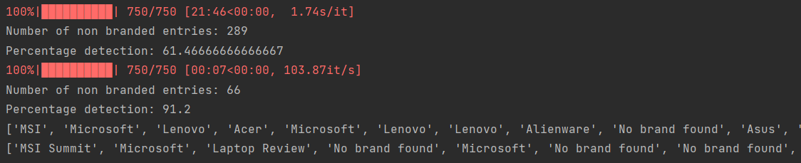
Problem and Results
Brand Outlook to better enhance consumer Outlook

Slide 5
Limitations-Webscraper
Data size
Data bias

Slide 6
Limitations – NLP Tasks
Data Bias
Pre-trained models used
Title structure

